Slide 1
C# Programming Basics
Goce Kalamadevski

Slide 2
Agenda
PART 1 – Visual Studio
VS Overview
Part 2 – The basics
Introducing oop, classes, interfaces, structures, namespaces, partial types
Part 3 – Additional
Enumerations, array, collections, indexers, generics, attributes, exceptions, extensions, anonymous t&M
PART 4 – LINQ
LINQ to Objects
PRACTICE, PRACTICE, PRACTICE
C# Programming Basics

Slide 3
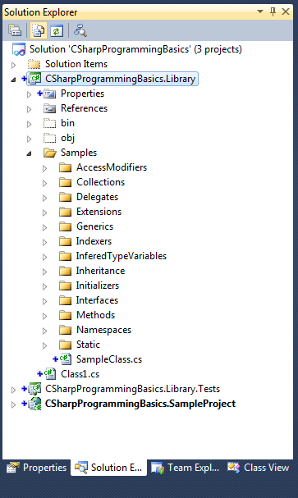
VS Overview
Solution
work in solution
solution contains projects
solution items
.sln
Projects
different types
different programming languages
different extension (.csproj)
Project structure
Properties
References
Project files and Folders
C# Programming Basics – Part1:Visual Studio

Slide 4
VS IDE Structure
Menu with menu options
File menu - manipulate the Solution;
View menu - displaying and hiding of the VS windows;
Project menu - manipulating the structure of the currently selected project;
Build menu - building the projects or the solution;
Debug menu - unning/debuging projects in the solution;
Test menu - manipulation and execution of unit tests;
Tools menu - additional tools provided by the VS
C# Programming Basics – Part1:Visual Studio

Slide 5

VS IDE Structure
Toolbars
File/project manipulation buttons
The Run button
Navigation toolbar options
Comment toolbar options
Use the View->Toolbars option for customizing!
C# Programming Basics – Part1:Visual Studio

Slide 6
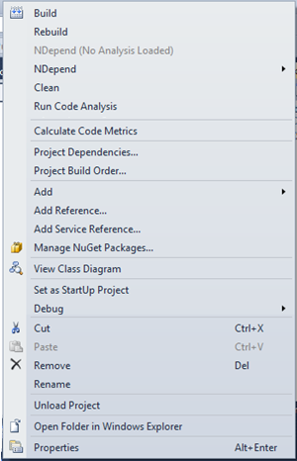
VS IDE Structure
Solution explorer
navigation;
structure (solution/projects);
select item to edit;
context menu.
C# Programming Basics – Part1:Visual Studio

Slide 7
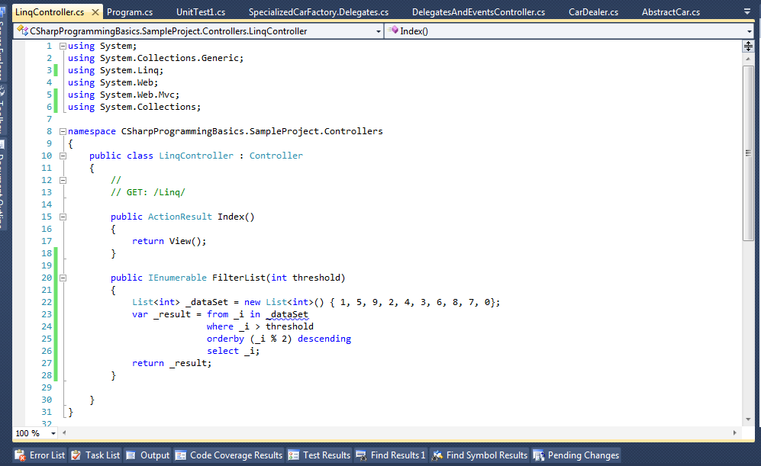
VS IDE Structure
Editor window
Edit the code or properties;
Different editors for different types of files;
Syntax highlight;
Design View (WinForm, WebForm, etc);
Other possibilities.
C# Programming Basics – Part1:Visual Studio

Slide 8
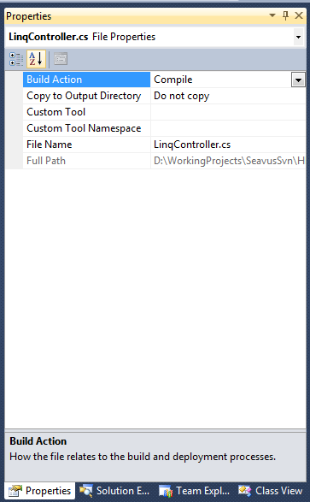
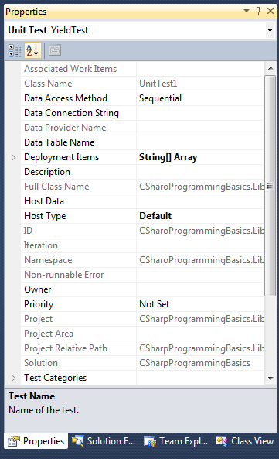
VS IDE Structure
Properties window
Properties of selected item;
Different properties;
Changes saved in file or code is created
View -> Properties window or F4
C# Programming Basics – Part1:Visual Studio

Slide 9
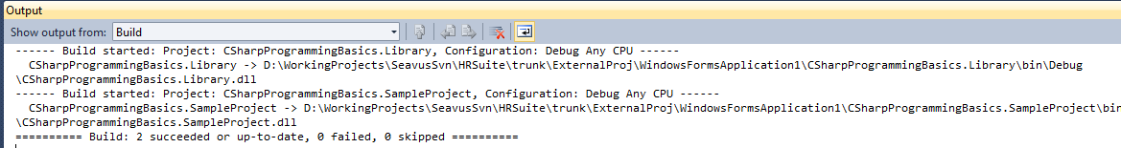
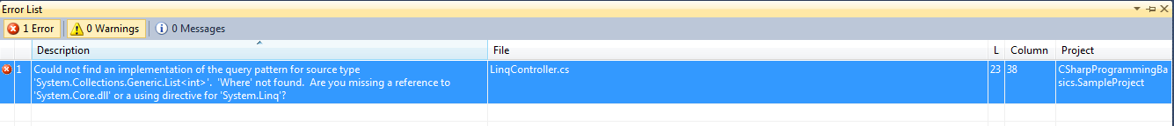
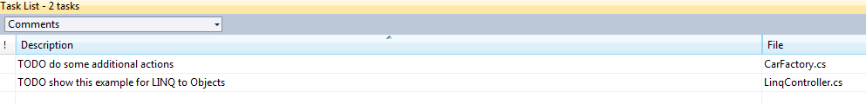
VS IDE Structure
Other result windows
Output window
Error list window
Task list window
Debug information windows
(Breakpoints, Immediate, Watch, Autos, Locals)
Test results window
C# Programming Basics – Part1:Visual Studio

Slide 10
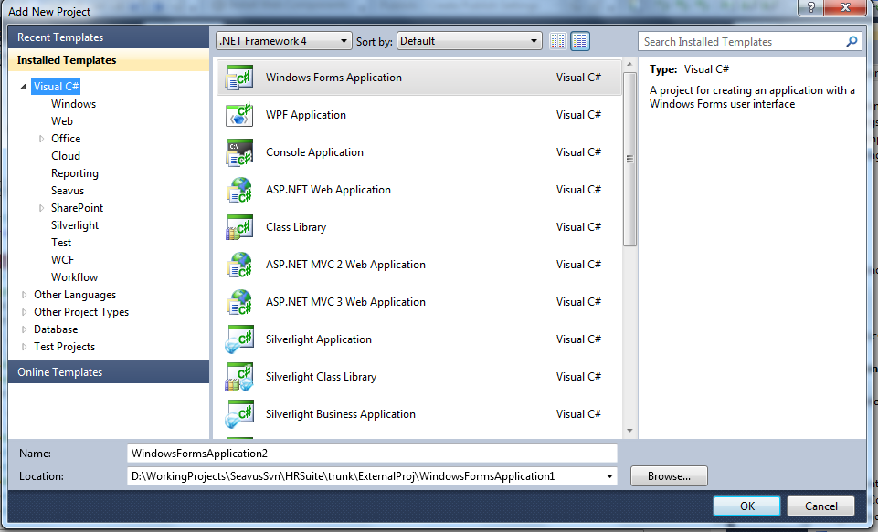
Projects
Types of projects
(Console application, Class library, Windows application, Web Application and other project templates)
Add->New project
Other project templates can be added!
C# Programming Basics – Part1:Visual Studio

Slide 11
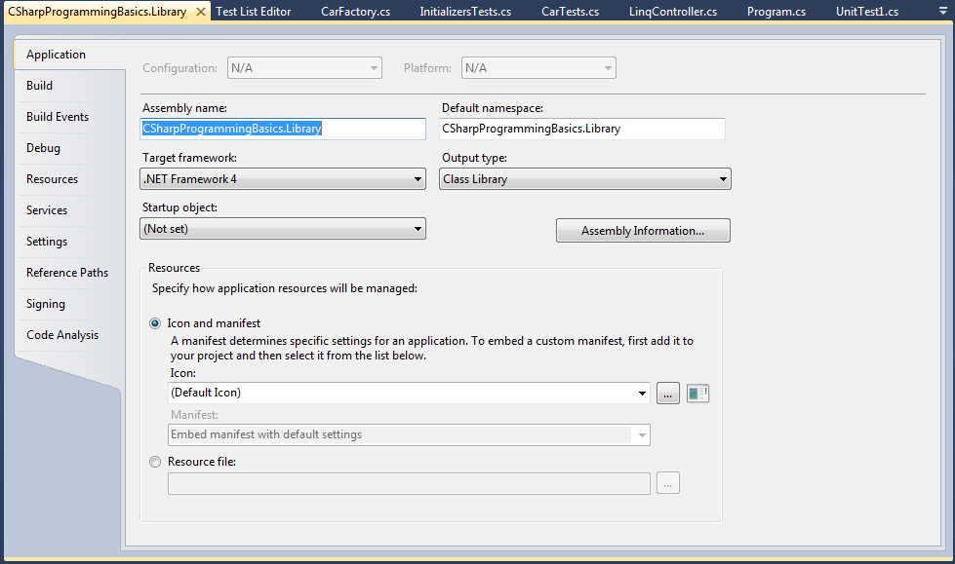
Projects
Project properties
Depend on project type
C# Programming Basics – Part1:Visual Studio

Slide 12
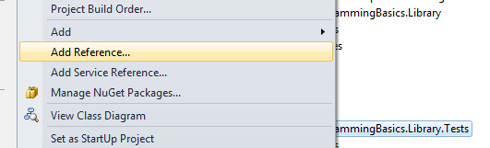
Projects
REFERENCES
Add Reference
Add Service Reference
APPLICATION CONFIGURATION
XML File
Configuration settings for class library is in the parent application config file
C# Programming Basics – Part1:Visual Studio

Slide 13

Writing code
Code file extensions (.cs, .vb…)
Designer file & Code behind file
Regions
code blocks
collapse/expand
Snippets
for- creates empty for loop
ctor-creates empty default constructor for the class
if- creates an empty if statement
region- creates a new region statement
while-creates an empty while loop
Custom code snippets can be defined!
C# Programming Basics – Part1:Visual Studio

Slide 14
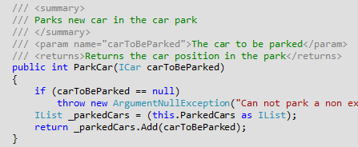
Writing code
Comments
//- single line comment
/* */ - code block
/// - to generate summary
Comments can be used to generate documentation!
SandCastle application
C# Programming Basics – Part1:Visual Studio

Slide 15
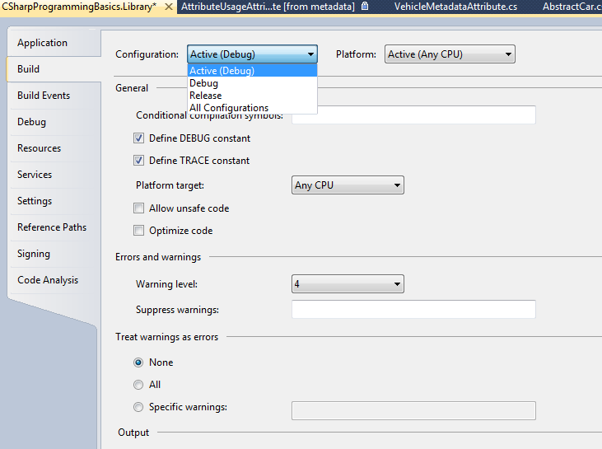
Running and Debugging applications
Building and build configuration
Debug/Relese build configuration or other
Configuration manager
C# Programming Basics – Part1:Visual Studio

Slide 16
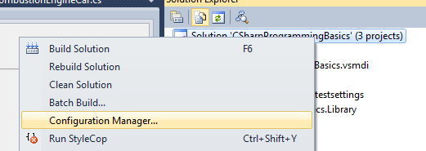
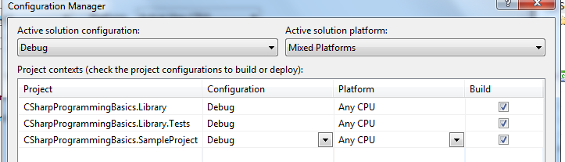
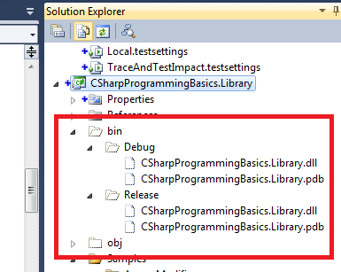
Running and Debugging applications
Building and build configuration
Configuration manager
Binary files as output
C# Programming Basics – Part1:Visual Studio

Slide 17
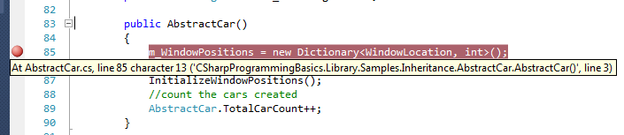
Running and Debugging applications
Debugging
Debug through the VS
Use breakpoints
Debug menu -> Windows -> Breakpoints
Other debug windows
C# Programming Basics – Part1:Visual Studio

Slide 18
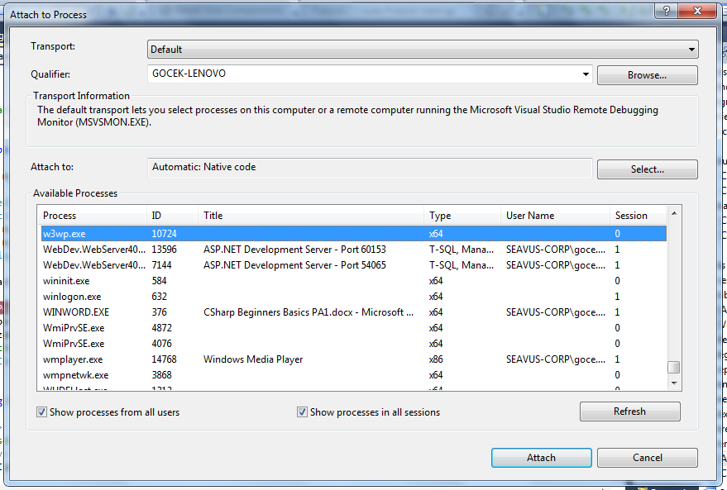
Running and Debugging applications
Attach to process
Loaded by other application
When debugging class library
Example: Web Application hosted in IIS
C# Programming Basics – Part1:Visual Studio

Slide 19
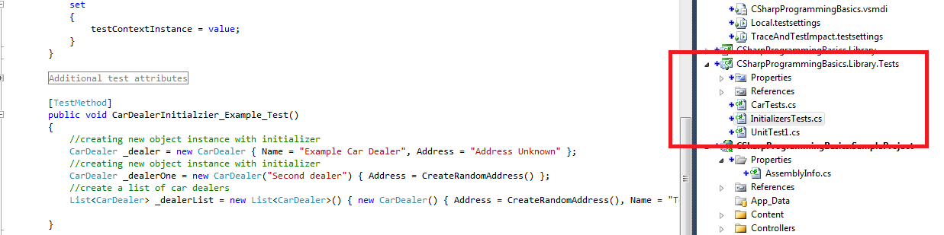
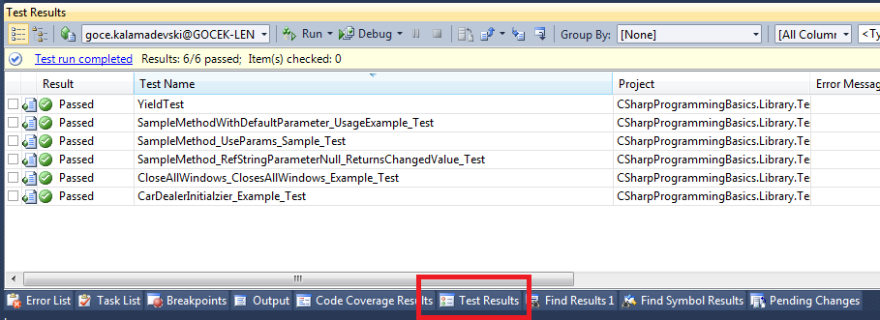
Testing applications
Write automated tests
Unit tests in Test Project
Test results window
C# Programming Basics – Part1:Visual Studio

Slide 20
LAB 01
Get to know VS
C# Programming Basics – Part1:Visual Studio

Slide 21
Introduction to OOP
What is OOP?
What is an object?
What is a class?
Instantiation
The “hand” is a class. Your body has two “objects” of type hand, named left hand and right hand.
The hand is a well architected class. ☺
C# Programming Basics – Part2:The Basics

Slide 22
Introduction to OOP
Key concepts in OOP
Abstraction - generalize an object as a data type
Inheritance – specialize capabilities
IS-A relationship
C# Programming Basics – Part2:The Basics

Slide 23
Introduction to OOP
Key concepts in OOP
Encapsulation –inclusion within a program object
The class is the container
GoForward, GoReverse are available but implementation is encapsulated under the hood
C# Programming Basics – Part2:The Basics

Slide 24
Introduction to OOP
Key concepts in OOP
Polymorphism–many shapes
Same operations, but different implementation
Achieved by overriding and overloading
C# Programming Basics – Part2:The Basics

Slide 25
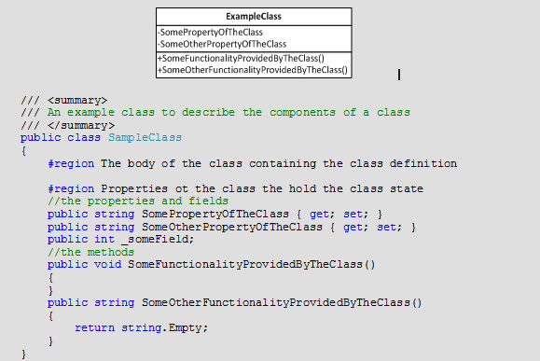
Defining classes
Class Name
Class Members
Class Attributes
C# Programming Basics – Part2:The Basics

Slide 26
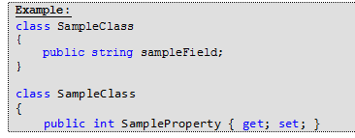
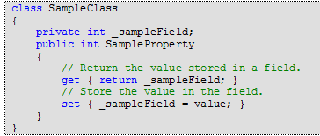
Class Members
Fields and Properties
represent information that an object contains;
variables that can be read or set directly;
properties have get/set methods;
auto-implemented properties.
Add logic in property implementation.
Define different access modifiers for get/set.
C# Programming Basics – Part2:The Basics

Slide 27
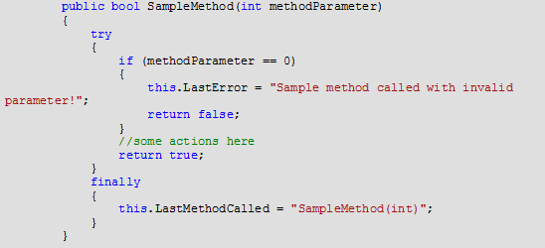
Class Members
Methods
actions offered by the class;
parameters and return values;
property get/set are methods;
part of class definition (except extension methods)
void methods;
parameter vs argument;
C# Programming Basics – Part2:The Basics

Slide 28
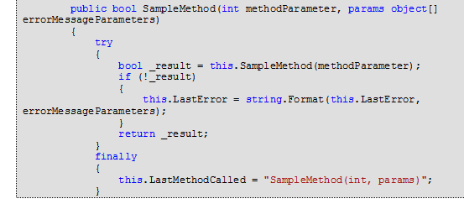
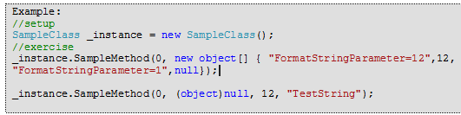
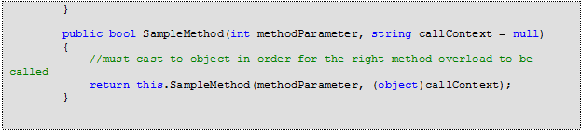

Class Members
Methods
params keyword, variable number of arguments -last parameter
-comma separated or array, or null
parameter default values
C# Programming Basics – Part2:The Basics

Slide 29
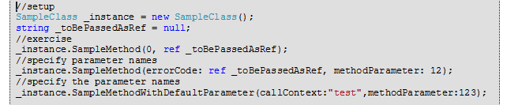

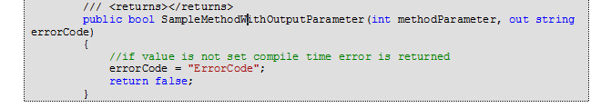
Class Members
Methods
specify parameter names
ref keyword –must be initialized before the call
out keyword – must be initialized in the body of method
C# Programming Basics – Part2:The Basics

Slide 30
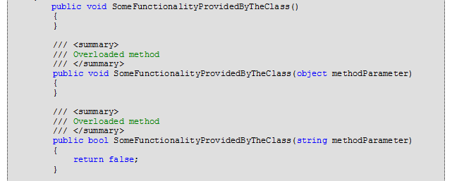
Class Members
Method overloading
same method name, different signature
return value is not part of the signature
ref and out leave the same signature
C# Programming Basics – Part2:The Basics

Slide 31
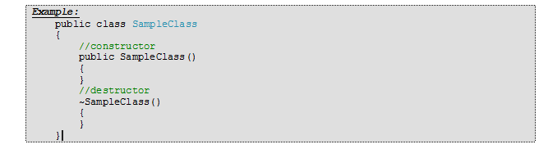
Class Members
Constructors
create a new instance
runs before any other code in a class
same name as the class
have parameters, default constructor without parameters
constructor overloads
Destructors
clean up any unmanaged resources
GC
C# Programming Basics – Part2:The Basics

Slide 32
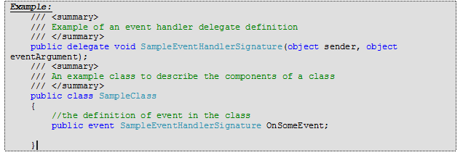
Class Members
Events
notify other classes or objects when something of interest occurs
references to a list of methods
class publishes the event, other classes subscribe
event keyword
C# Programming Basics – Part2:The Basics

Slide 33
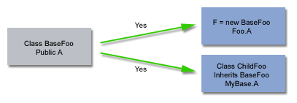
Access modifiers
public
private
protected
internal
protected internal
public
visible to everyone
accessed using an instance of a class,
accessed by a class's internal code,
accessed by any descendants of a class.
C# Programming Basics – Part2:The Basics

Slide 34
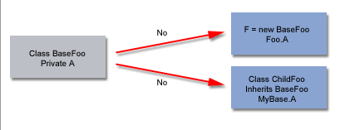
Access modifiers
private
visible only to internal code
inherited classes can not access the class members
C# Programming Basics – Part2:The Basics

Slide 35
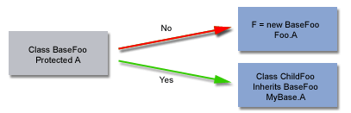
Access modifiers
protected
visible to internal code and inherited classes
C# Programming Basics – Part2:The Basics

Slide 36
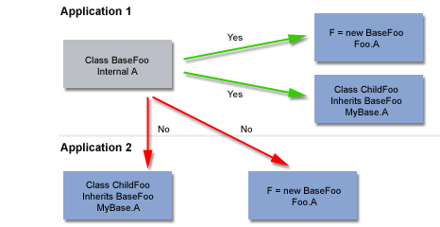
Access modifiers
Internal
public to all the classes in the assembly
private for classes in other assembly
C# Programming Basics – Part2:The Basics

Slide 37
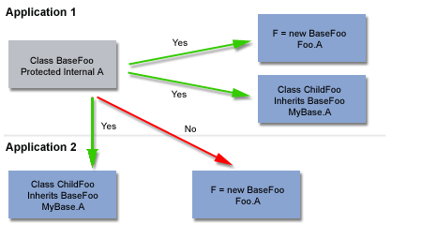
Access modifiers
Protected Internal
public to all the classes in the assembly
visible to inherited classes in other assembly
C# Programming Basics – Part2:The Basics

Slide 38
Inheritance
Reuse, extend and modify the behaviour of existing class
Base class and descendant or inherited class
Inherit from one class only (Object by default)
Abstract classes
can only be inherited
can have abstract members
members are virtual
abstract keyword
Example
Sealed classes
can not be inherited
sealed keyword
sealed is opposite from abstract
Example
C# Programming Basics – Part2:The Basics

Slide 39
Inheritance
Override members
key mechanism for different behaviour, polymorhpusm
Keyword override and new
Override with override
only virtual, abstract or override
same signature
same access modifier
can‘t use new
Example
Hiding with new
override non-virtual members
can be omitted (compiler gets angry ☺)
different from override
Example
C# Programming Basics – Part2:The Basics

Slide 40
Static entities
static keyword
used on classes, fields, methods, properties, operators, events and constructors
not used on indexers, destructors
members belong to the type
Static Classes
can not be instantiated
can have static constructor
must contain static members
can not override, new
Example
C# Programming Basics – Part2:The Basics

Slide 41
Static entities
Static Members
part of static or non-static class
accessed through the type
one “copy” no matter how many instances
can not use this
can not reference non-static members
can not override, can overload
can access const
initialized before constructor
Example
C# Programming Basics – Part2:The Basics

Slide 42
Interfaces
interface defines a contract
Interface can inherit from multiple interfaces (aha ☺)
don‘t provide implementation (abstract ?)
access modifier on interface level not member level
declare zero or more members
methods, properties, events or indexers
combined set of defined and inherited members
Example
C# Programming Basics – Part2:The Basics

Slide 43
Interfaces
Interface implementation
by classes and structs
implicitly implements all inherited interfaces
Example
Explicit interface implementation
referenced by fully qualified interface member name
if interface member name is not appropriate for the class
accessed though the interface not the instance
can not specify modifiers abstract, virtual, override
Example
C# Programming Basics – Part2:The Basics

Slide 44
Structures
value type, not reference types
for small data structures, value semantics
no inheritance
can’t initialize fields (const and static only)
can‘t define default constructor
can define constructors with parameters
can instantiate with/out new
inheritance System.ValueType → System.Object
can implement interfaces
can’t assign null, can be define as Nullable<T>
can contain filed of reference type
copied on assignment (beware Dictionary<type, myStruct>)
Example code
Example usage
C# Programming Basics – Part2:The Basics

Slide 45
Namespaces
consider as a scope for the code
for internal organization, but used by compiler as well
namespace keyword
implicitly public (access modifier not allowed)
nested namespaces (using . notation)
Example:
Notation 1 | Notation 2
namespace N1.N2 { class A {} class B {} } | namespace N1 { namespace N2 { class A {} class B {} } }
C# Programming Basics – Part2:The Basics

Slide 46
Namespaces
Using namespaces
using keyword
to include types from other namespace
to define alias (Example AbstractCarStatics)
Namespace alias qualifier
:: operator
define which namespace to use for type lookup
useful when having ambiguous names (Example)
global, predefined alias for global namespace
C# Programming Basics – Part2:The Basics

Slide 47
Partials
Partial types
split definition in multiple files
partial keyword (in all parts)
same access modifier
partial keyword must appear before class, struct or interface
all parts must be in the same assembly
all parts must be present in compile time
class name and generic parameters must match
Example
Partial methods
split declaration from definition
private void
can have only ref not out parameters
can be generic
can define delegate to implemented not just declared method
can’t implement interface members
Example
C# Programming Basics – Part2:The Basics

